Slide 1
Augmented Reality: Travel and Tourism
Presented By:
Aravind Sheri
Sharath Koppu
V Bhanu Sudheer
Aditya Somam

Slide 2
Introduction
Deals with Travel and Tourism.
Especially useful for a tourist travelling to another country where different languages are spoken.
Implementing a Login/Register page; and a google oAth as an option.
Integrating Google Maps and Translate api’s to the application.
Will integrate a weather api also.
Will include a First Aid instruction manual in the future.

Slide 3
Increment 1
Included a Register/Login page where the user can register their username and password.
Implemented a Google oAuth 2.0 login as an option also.

Slide 4
Main Page
The user after logging in is directed to this page.
All the activity is centered in this page.
Implemented a text to text language translator using Watson .
User has to select the from and to languages from a dropdown.
User will enter the text to be translated and click on a translate button.
The application will translate the text and display the translated text.
User will also have the option to logout once used.

Slide 5
Future increment
Will implement a auto location detect so that the From Language will automatically be detected; although the user will still have an option to select.
Will implement a weather api, based on the user’s location.

Slide 6
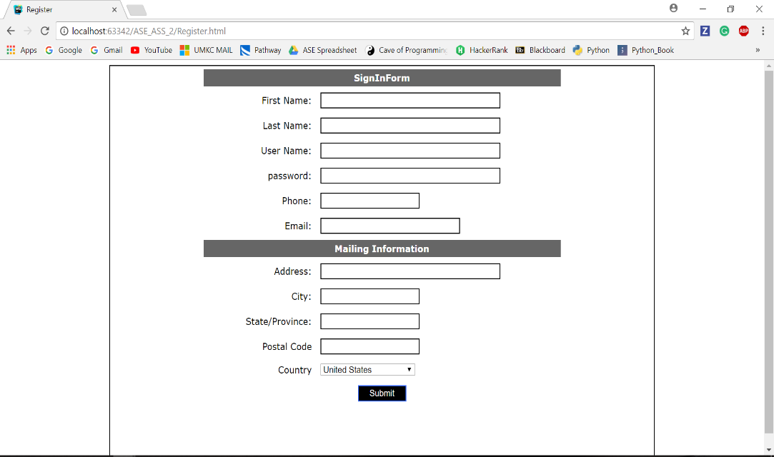
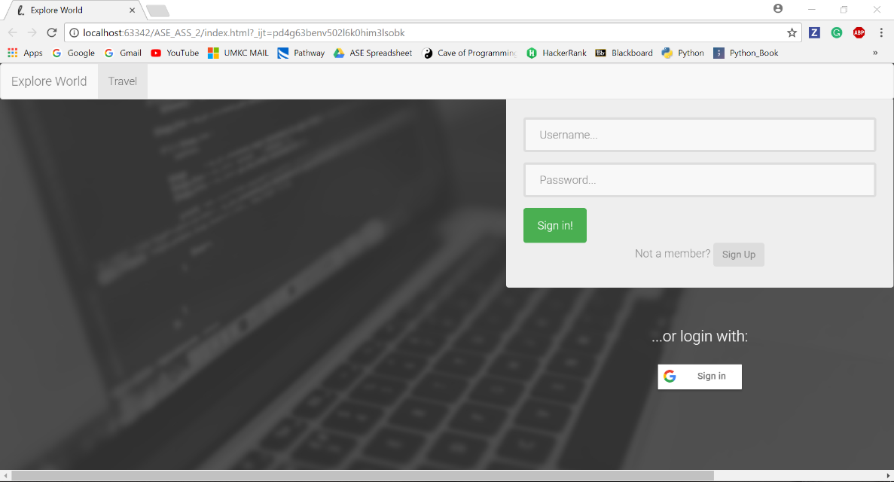
Related Images
Register Screen
Login screen

Slide 7
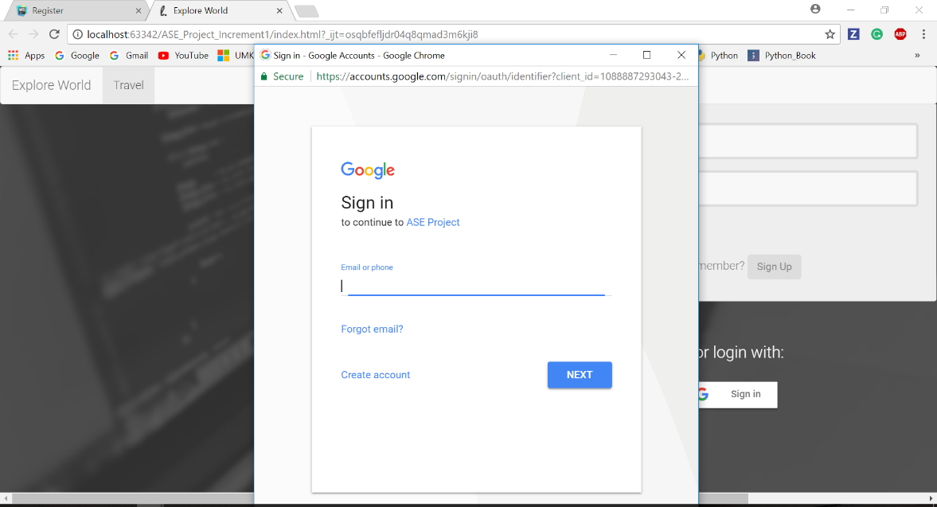
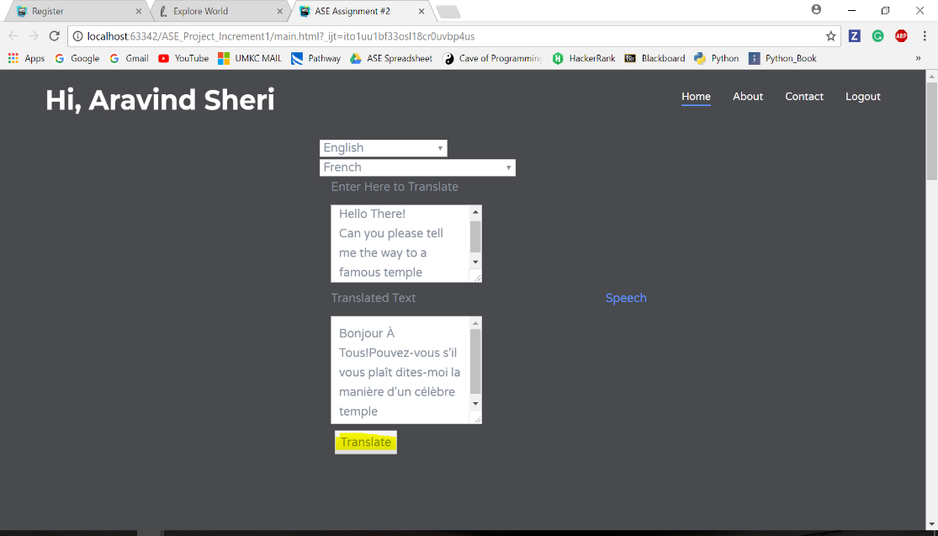
Related Images
Google oAuth 2.0
Main Page

Slide 8
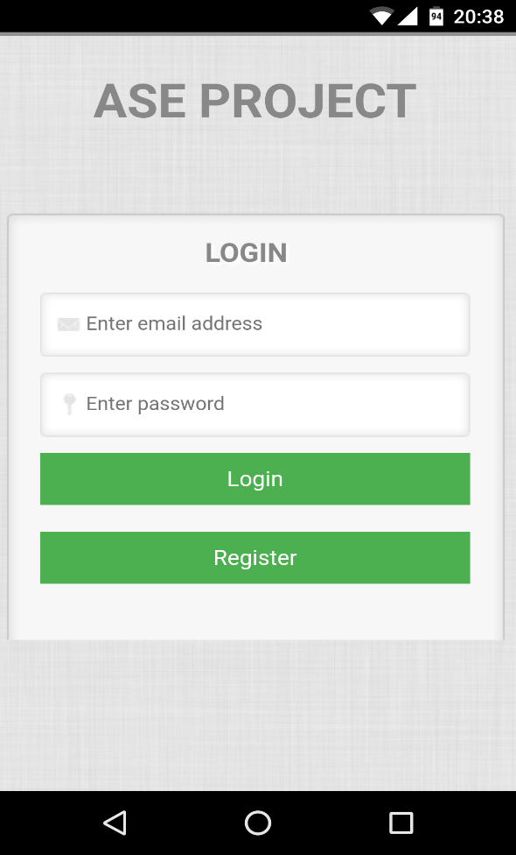
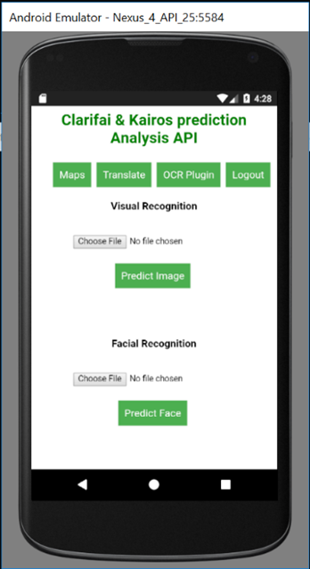
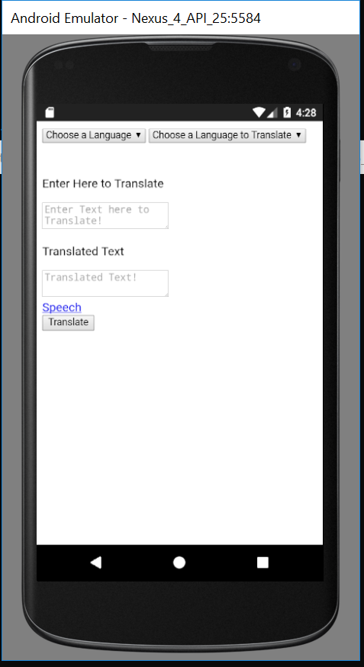
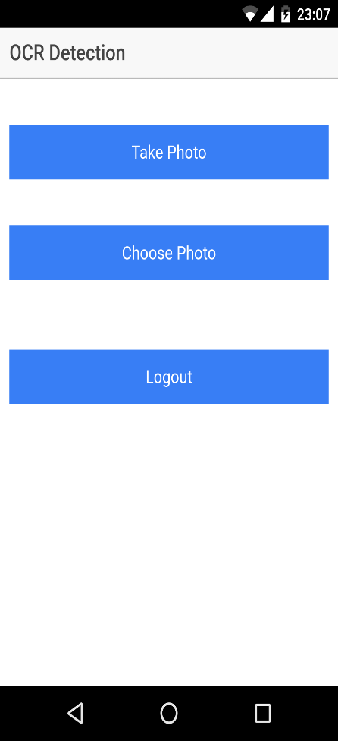
Increment 2
Login Screen
Home Screen
Language Translate
OCR Screen

Slide 9
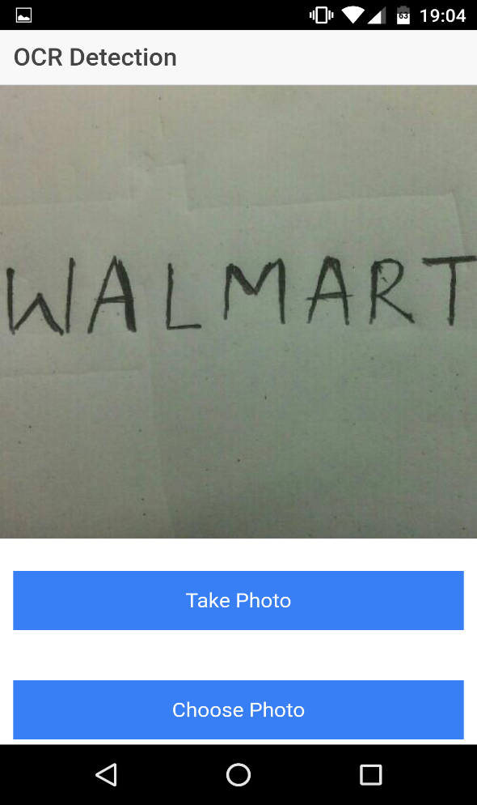
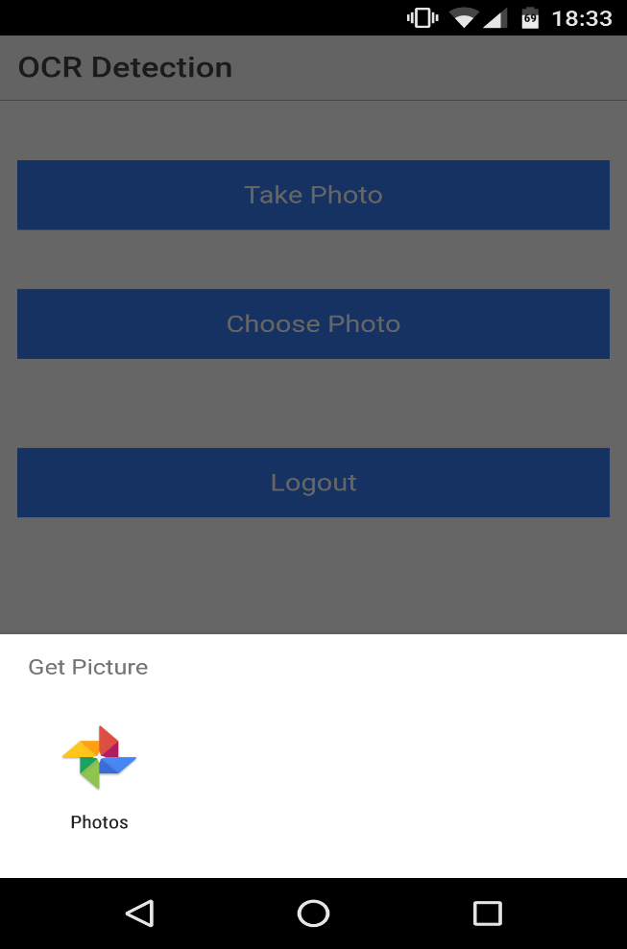
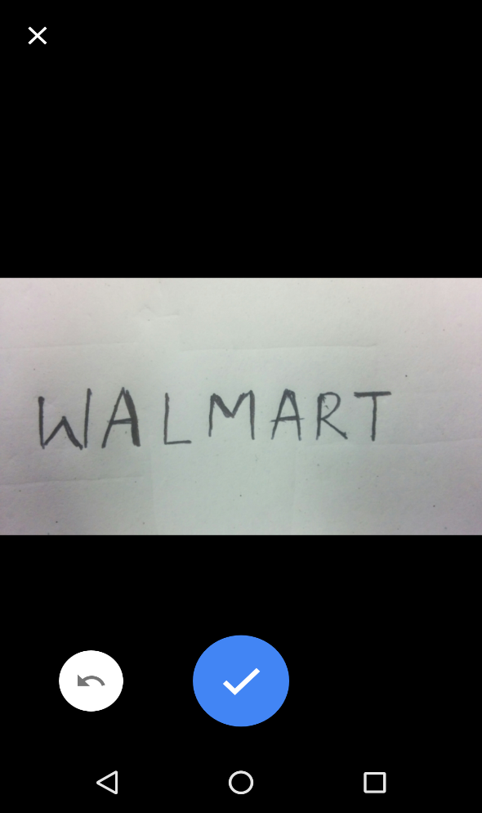
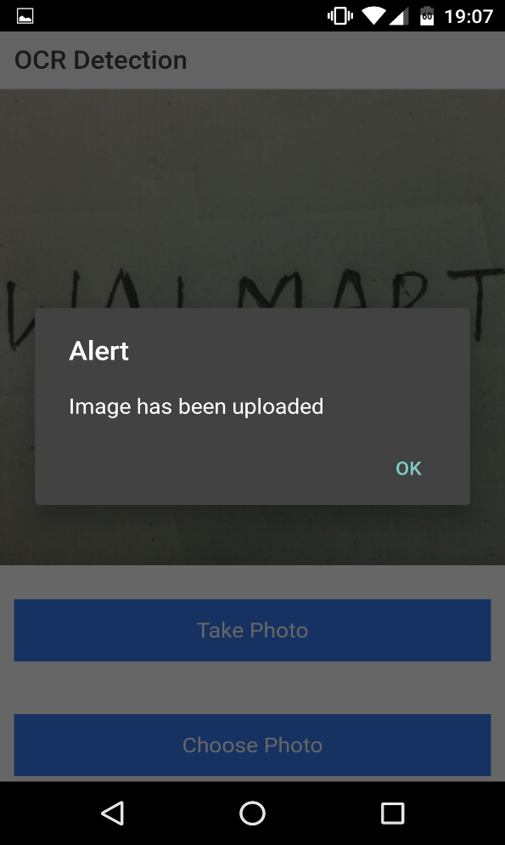
Add/Select Images
Take a photo
Choose a photo from memory
OCR Detection
Image uploaded alert

Slide 10
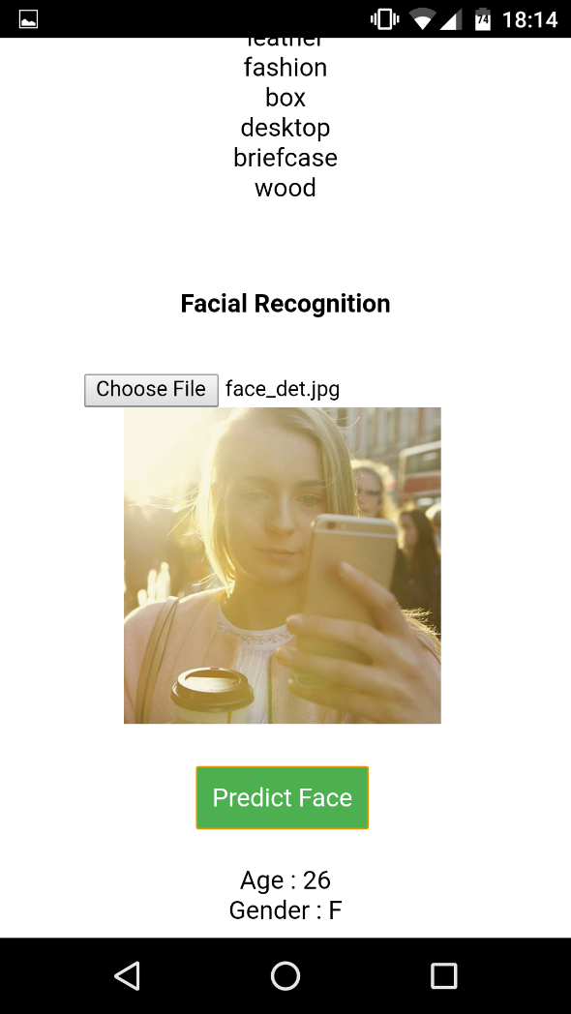
Face Recognition

Slide 11
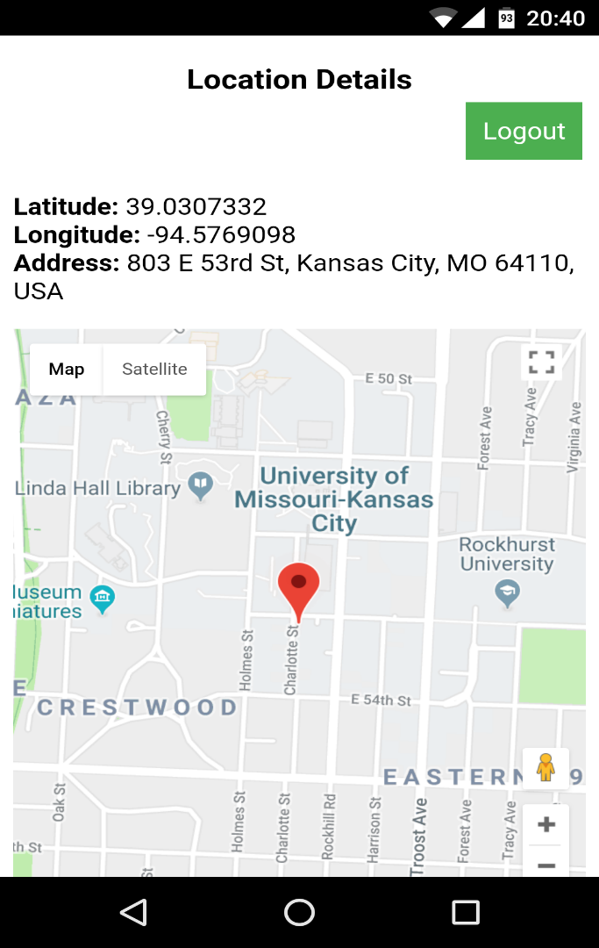
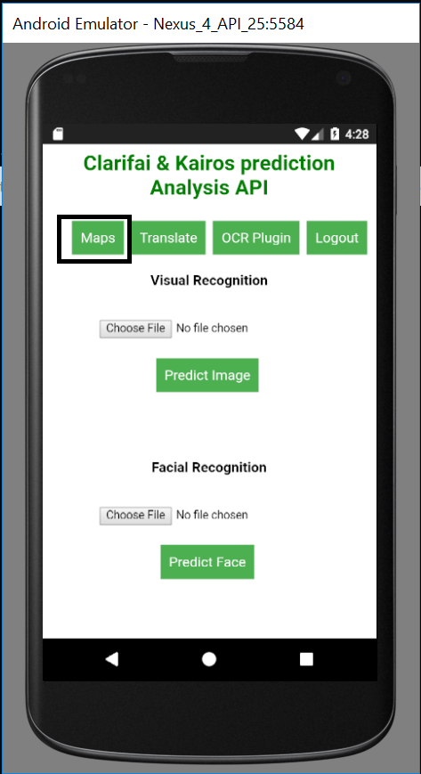
Location and Maps
Maps Option
Current Location

Slide 12
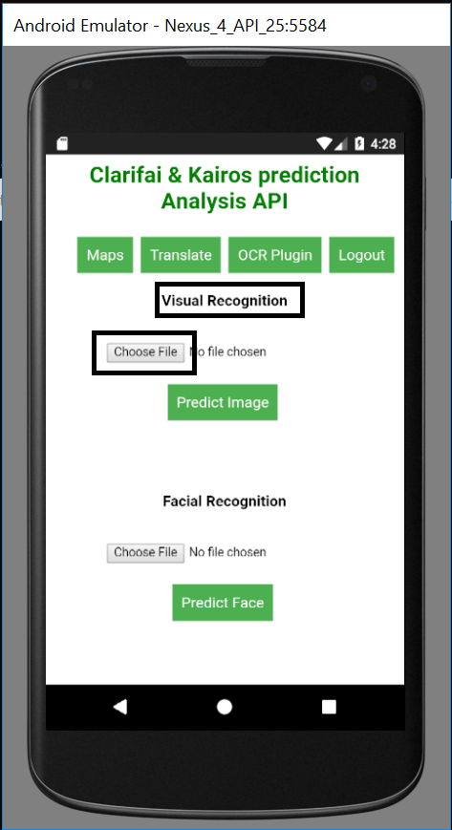
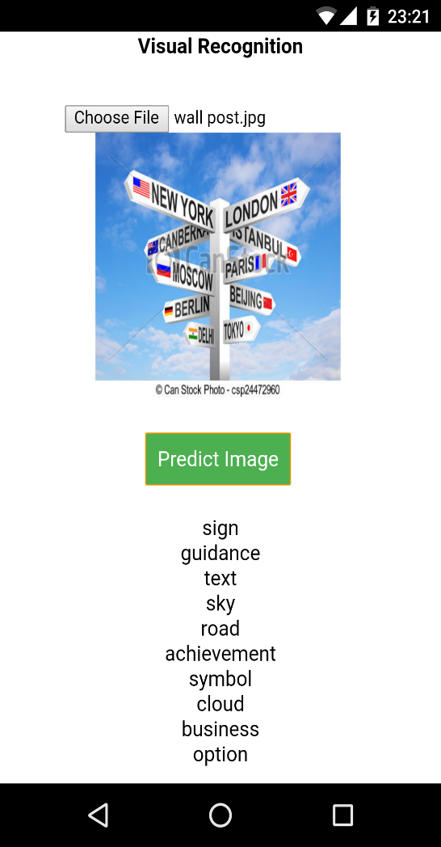
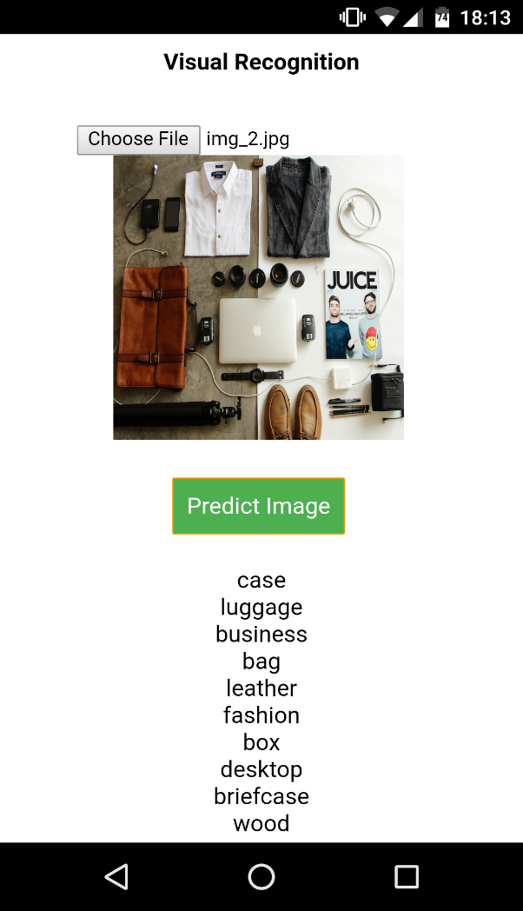
Visual Recognition
Visual Detection Option
Visual Recognition
Visual Recognition

Slide 13
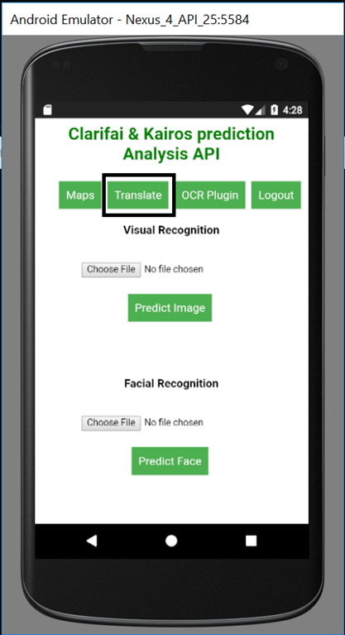
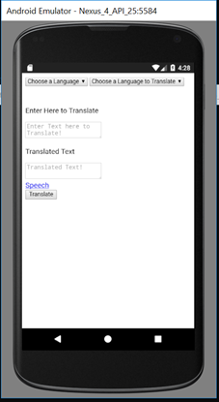
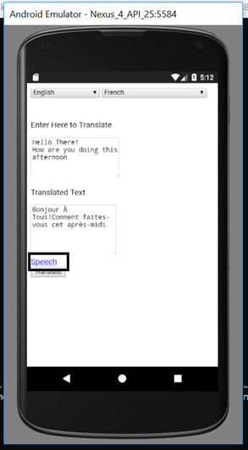
Translation
Translate Option
Translation Screen
Speech Option

Slide 14
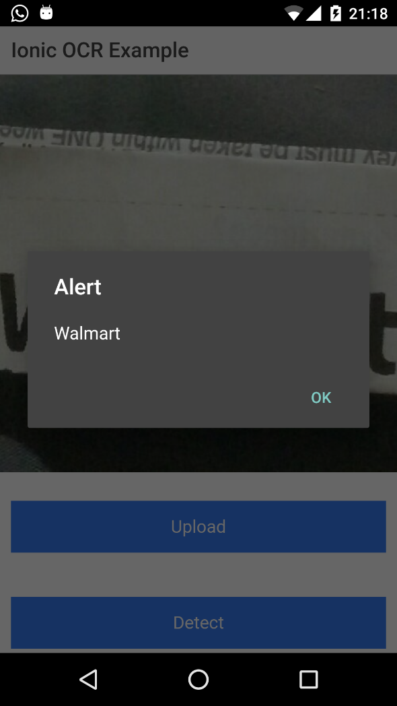
Ionic OCR Detection

Slide 15
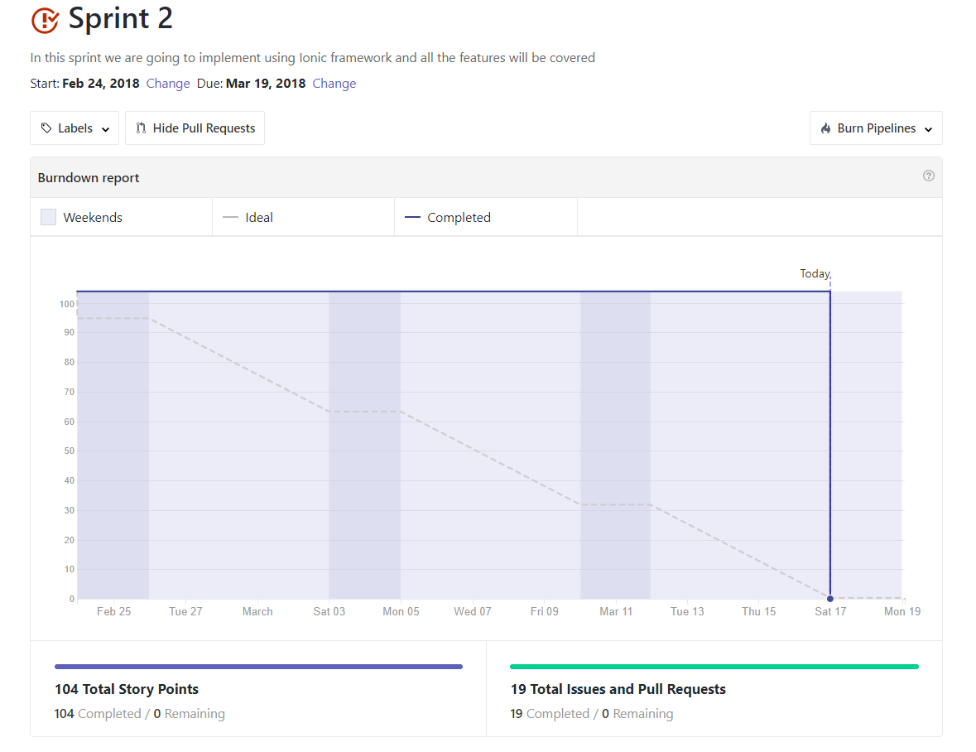
Sprint 2 Burndown Chart

Slide 16
Progress
Implemented Visual Recognition
Implemented Face Detection
Implemented Language Translate
Implemented OCR Detection

Slide 17
Future Implementations
Implement auto detect location
Integrate Maps.
Integrate Augmented Reality

Slide 18
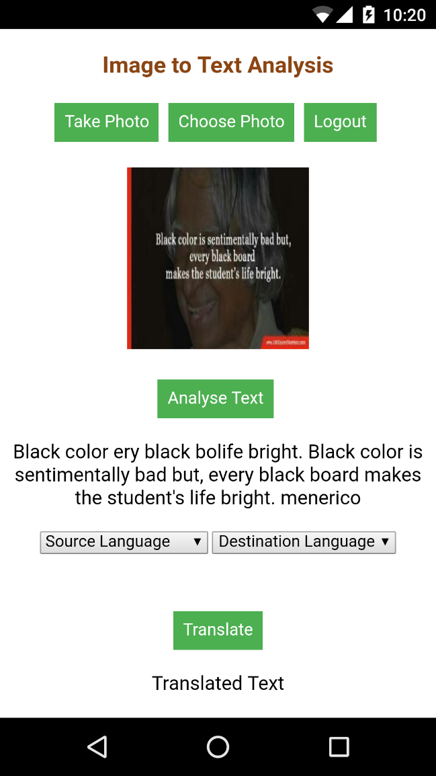
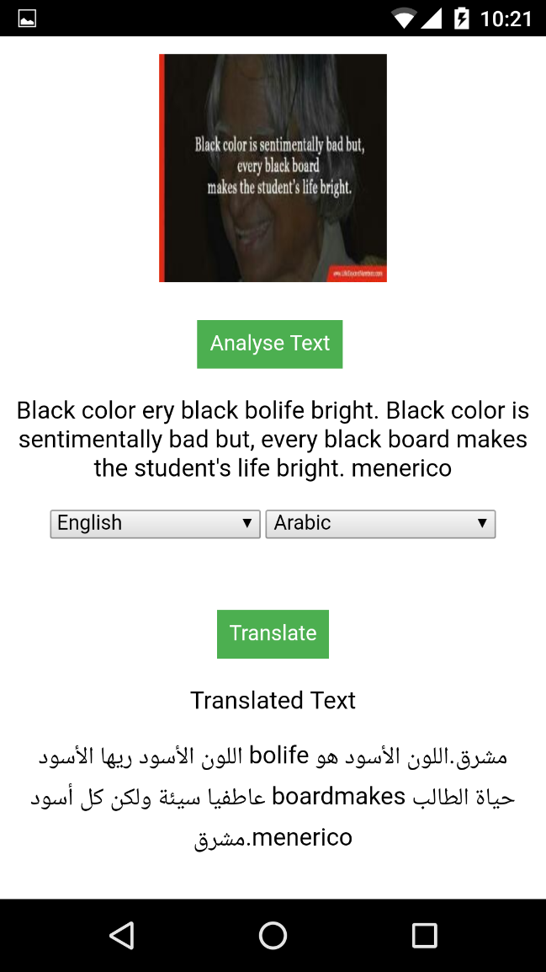
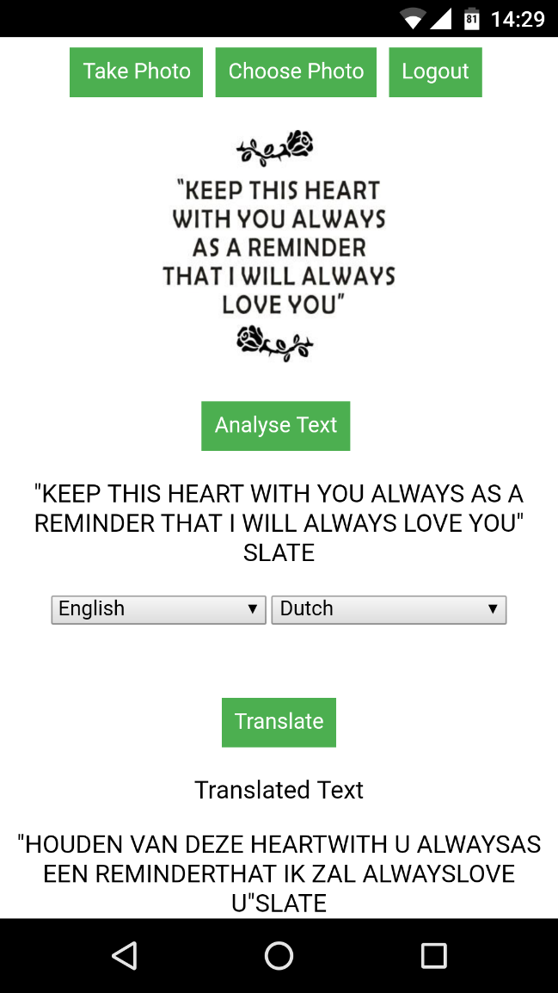
Increment 3 (Google OCR)

Slide 19
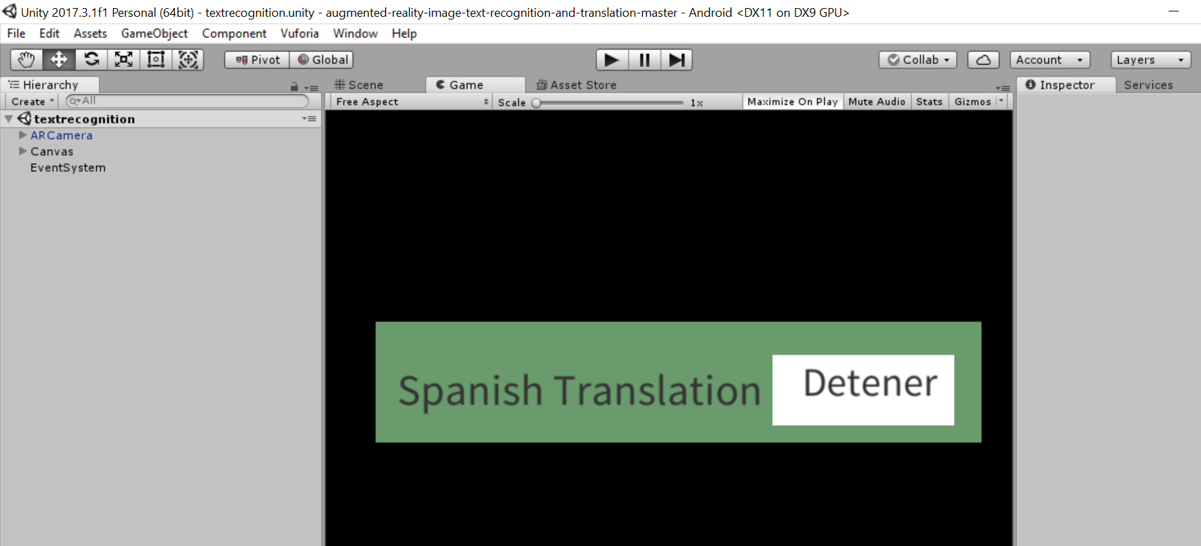
Augmented Reality

Slide 20
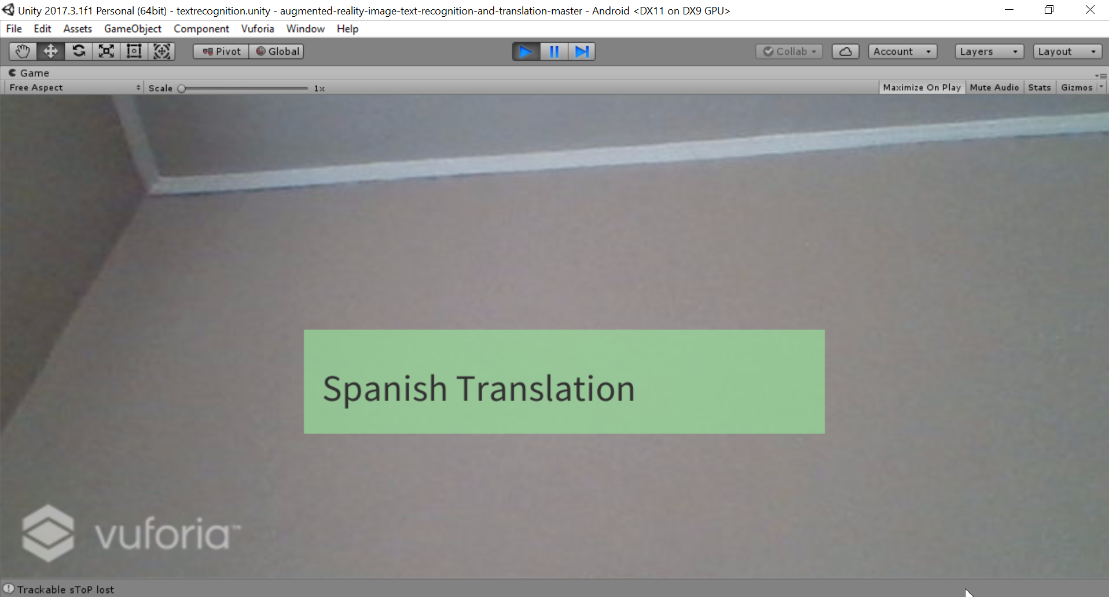

Slide 21
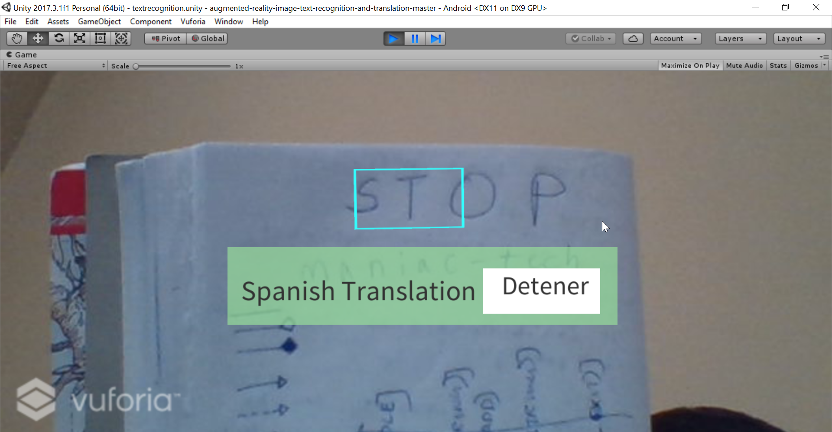

Slide 22
Progress
Implemented Google OCR
Implemented Augmented Reality

Slide 23
Feature Implementations
Social Media Analysis
Integrating Augmented Reality with Ionic

Slide 24
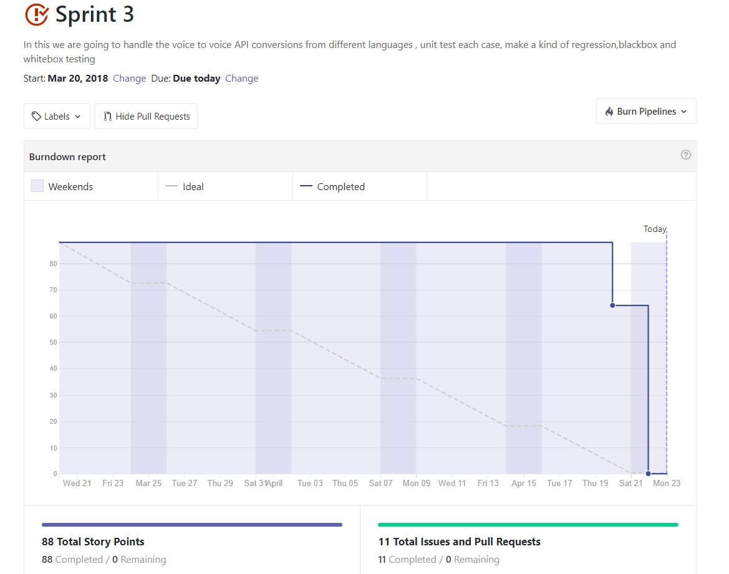
Sprint3 Burndownchart

Slide 25
Thank You!!!

